Slide 1
Change Request Management in Requirement Engineering

Slide 2
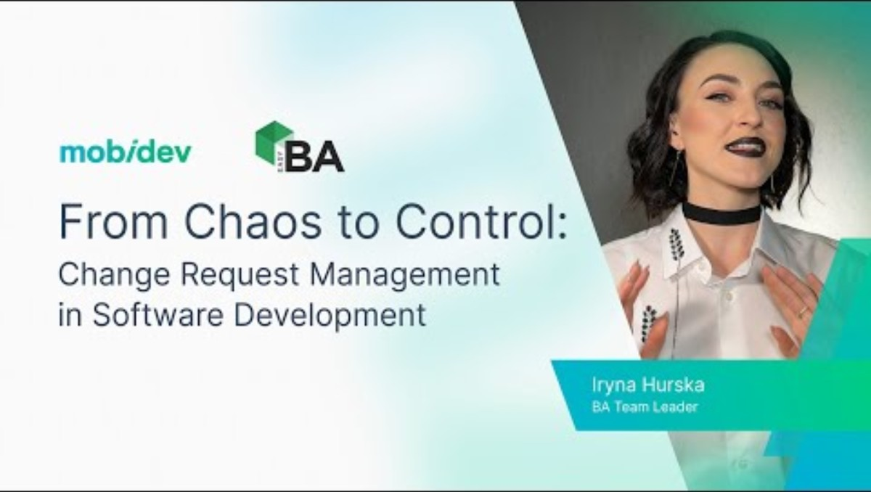
An overview of change request management and its importance in software projects

Slide 3

Introduction to Change Request Management (CRM)
Definition: A systematic process to manage modifications in requirements after initial agreement.
Importance: Maintains project scope, timeline, and budget.
Key Phrase: 'Change is inevitable, but must be managed.'
Notes:
Definition: Change Request Management (CRM) refers to the structured approach used to manage changes to the software requirements after the initial agreement. It ensures that any requested modifications are assessed, approved, implemented, and documented properly.
Importance: Without a proper CRM process, projects may face scope creep, budget overruns, and delays. It provides control over the development process and aligns the outcome with stakeholder expectations.
Key Phrase: This highlights the inevitability of changes in software projects and emphasizes the need for a systematic way to manage them

Slide 4

Why Changes Occur in Requirements
Evolving business needs - Businesses grow and shift priorities, requiring updates to existing functionalities.
Errors or omissions in requirements - Initial requirement gathering may overlook some user needs or system constraints.
Technological changes - Emerging technologies may offer better solutions or require adjustments.
Stakeholder feedback - Continuous input from users or stakeholders can reveal new insights
Regulatory updates - Compliance with new laws or standards might necessitate changes

Slide 5

The Change Request Lifecycle
1. Submission - Anyone involved in the project can submit a formal request for a change.
2. Impact Analysis - The proposed change is evaluated for its effects on cost, time, quality, and scope.
3. Approval/Review - A Change Control Board (CCB) or designated authority decides whether to approve or reject the change.
4. Implementation - Once approved, the change is developed and integrated into the system.
5. Verification & Closure - The change is tested, validated, and documented to close the request.

Slide 6
Roles Involved in CRM
Project Manager: Oversees the change process. Ensures that changes align with project goals
Business Analyst: Conducts impact analysis - Analyzes and documents the impact of changes on requirements and business goals.
Stakeholders: Initiate/approve changes - Provide insights and approval for changes that impact their areas
Developers & Testers: Implement and validate changes - Responsible for coding and testing the changes once approved.

Slide 7
Change Request Form Components
Change ID
Description of the change
Reason for the change
Priority/Severity
Impact assessment
Approval section
Notes:
Change ID: A unique identifier for tracking the request.
Description of the change: A clear explanation of what is being proposed.
Reason for the change: Justification for the change, such as new requirements or bug fixes.
Priority/Severity: Indicates how critical the change is.
Impact assessment: Analysis of how the change affects various aspects of the project.
Approval section: Space for relevant authorities to approve or reject the change.

Slide 8
Impact Analysis
Scope analysis - Determines how the change affects current deliverables
Time and cost estimation - Evaluates the additional resources required
Risk identification - Considers potential risks introduced by the change.
Dependencies - Analyzes if the change depends on or impacts other components.
Resource availability - Checks whether required personnel and tools are available.

Slide 9
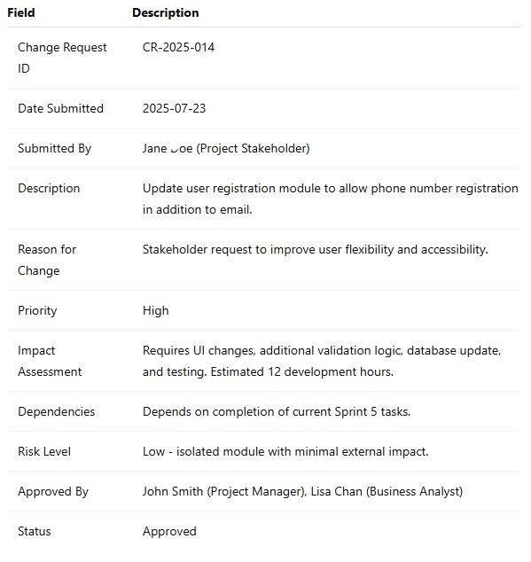
Sample Change Request Form

Slide 10
Change Control Board (CCB)
Definition: A committee that reviews and approves/rejects changes
Members: Project manager, lead analyst, stakeholder reps
Decision criteria: Benefit vs. risk, cost, feasibility
Notes:
Definition: A formal group responsible for reviewing and deciding on change requests.
Members: Typically includes the project manager, technical lead, quality assurance, and stakeholder representatives.
Decision criteria: Decisions are based on factors such as feasibility, cost, impact, and benefit to the project.

Slide 11
Tools for CRM
JIRA - : Widely used tool for tracking issues, bugs, and changes.
ServiceNow - Enterprise tool for managing IT service workflows, including change requests.
ChangeGear - Designed for ITIL-compliant change management
Microsoft Azure DevOps - Integrates requirement tracking with development pipelines.
Notes:
ITIL - Information Technology Infrastructure Library, a set of best practices for IT service management

Slide 12

Integrating CRM with Requirement Engineering
Traceability matrix updates: Ensures that all changes are linked to original requirements.
Requirement document versioning: Tracks revisions to maintain a history of changes.
Change logs: Logs all changes made, when, and by whom for audit purpose

Slide 13
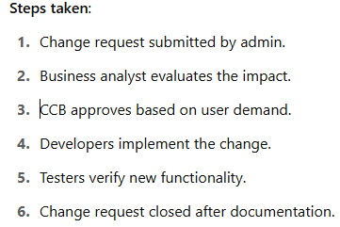
Example Scenario
Project: University Management System
1
Initial requirement: Register students by email only
2
Change requested: Allow phone number registration
3
Steps taken: Impact analysis > Approval > Implementation > Testing
4

Slide 14
Best Practices in CRM
Maintain detailed documentation - Ensures traceability and transparency
Communicate changes to all parties - Avoids confusion and misalignment
Evaluate changes continuously - Encourages proactive planning
Use proper tools - Increases efficiency and reduces manual errors
Monitor cumulative impact - Prevents overall project deviation

Slide 15
Challenges in CRM
Frequent scope creep - Too many unplanned changes can derail the project
Resistance from stakeholders - Not everyone may support a change
Poor documentation - Leads to confusion or miscommunication
Underestimation of change impact - Can result in delays or cost overruns

Slide 16

Case Study Summary
Real/Fictional Case: A hospital software system needed to include pandemic tracking features mid-project.
Change: Add COVID-19 case tracking module.
How managed: Request submitted, rapid impact analysis, prioritization by CCB.
Outcome: Feature added in 2 weeks, successfully deployed, improved system usefulness.

Slide 17
Conclusion and Q&A
Recap of CRM importance - Manages changes effectively, maintaining qualit
Key takeaway: 'A good change request process reduces chaos and increases project success.'
Invite questions from audience

